Slide 1
ITM7000 Master project
Dr. Qizhen Gu (Kimi)

Slide 2
selecting individual research topics
Step 1: Identify Personal Interest and Motivation
Step 2: Conduct a Preliminary Literature Scan
Step 3: Define the Scope Clearly
Step 4: Apply a Relevant Theoretical Framework
Step 5: Determine Data Availability and Collection Feasibility
Step 6: Ensure Practical Relevance and Contribution
Step 7: Ensure Research Originality and Avoid Duplication
Step 8: Assess Alignment with Course Objectives
Step 9: Draft a Concise Research Proposal

Slide 3
selecting individual research topics
Step 5: Determine Data Availability and Collection Feasibility
Consider your access to primary data sources, such as surveys or experiments, and the availability of reliable secondary data.
Research methodology (quantitative approach with surveys, is practical within your resources and timeframe..

Slide 4
selecting individual research topics
Step 6: Ensure Practical Relevance and Contribution
Aim to select a topic that not only contributes academically but also has practical business implications or addresses real-world business problems.
Clearly articulate potential implications or benefits for managers, marketers, policymakers, or the industry.

Slide 5
conceptual framework
Order Convenience
H1
Repurchase Intention
H2
Perceive Value
H3
H6
H4
H5
Satisfaction
Service Encounter

Slide 6
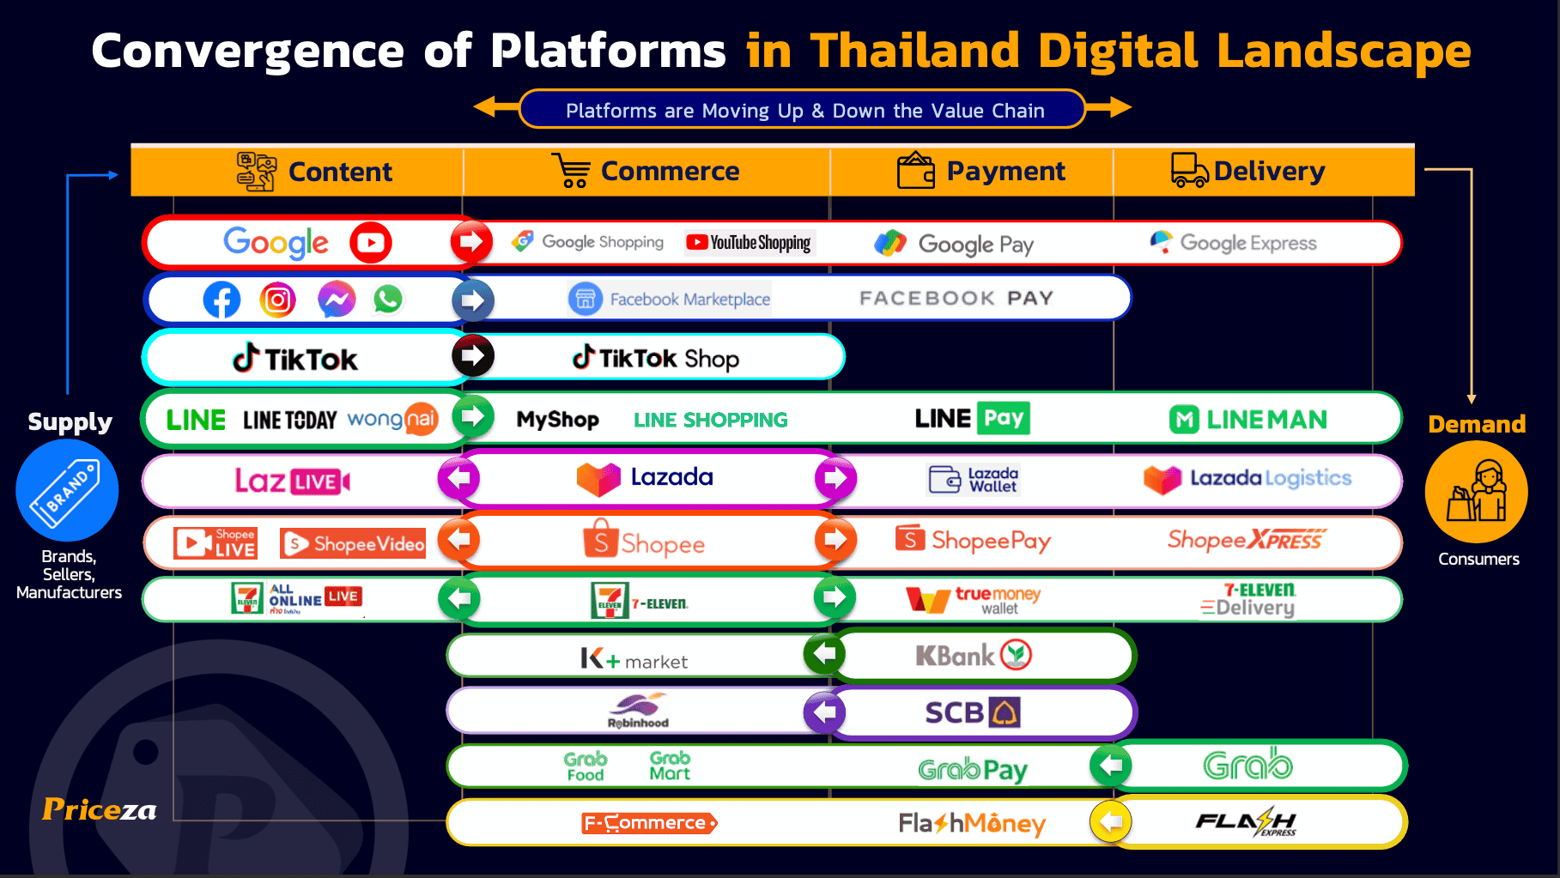
Select one platform

Slide 7
selecting individual research topics
Step 7: Ensure Research Originality and Avoid Duplication
Check if similar studies have already been extensively covered. Aim for topics that explore new perspectives, markets, methodologies, or theoretical applications.
Clearly articulate how your research addresses a specific gap in existing knowledge or literature.

Slide 8

Ensure Research Originality and Avoid Duplication
Does have to be completely new.
New perspectives – (different study goals: impact VS differences)
Markets – (in different countries; different group of people)
Methodologies – (qualitative VS quantitative VS mix)
Theoretical applications - (different framework; different variables)

Slide 9
selecting individual research topics
Step 8: Assess Alignment with Course Objectives
Ensure your selected topic aligns with the core objectives and competencies emphasized in your ITM program, such as strategic thinking, analytical abilities, leadership, and innovation management (especially in your recommendation part).

Slide 10
selecting individual research topics
Step 9: Draft a Concise Research Proposal
Clearly outline your topic, objectives, theoretical foundation, methodology, and expected contribution.
This proposal should serve as a brief roadmap for your research and facilitate feedback from faculty or peers.

Slide 11

A brief Research Proposal

Slide 12
Research Proposal
Title of the research
Introduction – introduce the background of the current situation
Statement of the problem – what’s the gap between the current situation and the expected situation
Research Objectives - To investigate the impact of XXX(IV) on XXX(DV)

Slide 13
Research Proposal
Theoretical Framework – the framework that you borrowed from pervious studies
Methodology - quantitative research; how many respondents you plan to collect, who you plan to collect from, and how you plan to collect them; how you plan to analysis your data and test your hypothesis
Contribution – who can benefit from your study.
Keywords – Model name; DV; location…. etc.

Slide 14
Assignment 2#
Research proposal:
Title of the research
Introduction – 3~4 sentences
Statement of the problem - 3~4 sentences
Research Objectives - one objective for one hypothesis
Theoretical Framework - 1~2 sentences for each framework
Methodology - 3~4 sentences
Contribution - 3~4 sentences
Keywords – 3~5 keywords

Slide 15
Thank you
Faculty member of ITM
guqizhen@au.edu

Slide 16
Guest speaker Prof.Dr.lars
Wed,4 June 2025
AI BASED TECHNOLOGY AND SMART MARKETING
A72 HUAMAK CAMPUS, 10:00-11:45

